Slide 1
Quarterly Profit Analysis by Country and Product

Slide 2
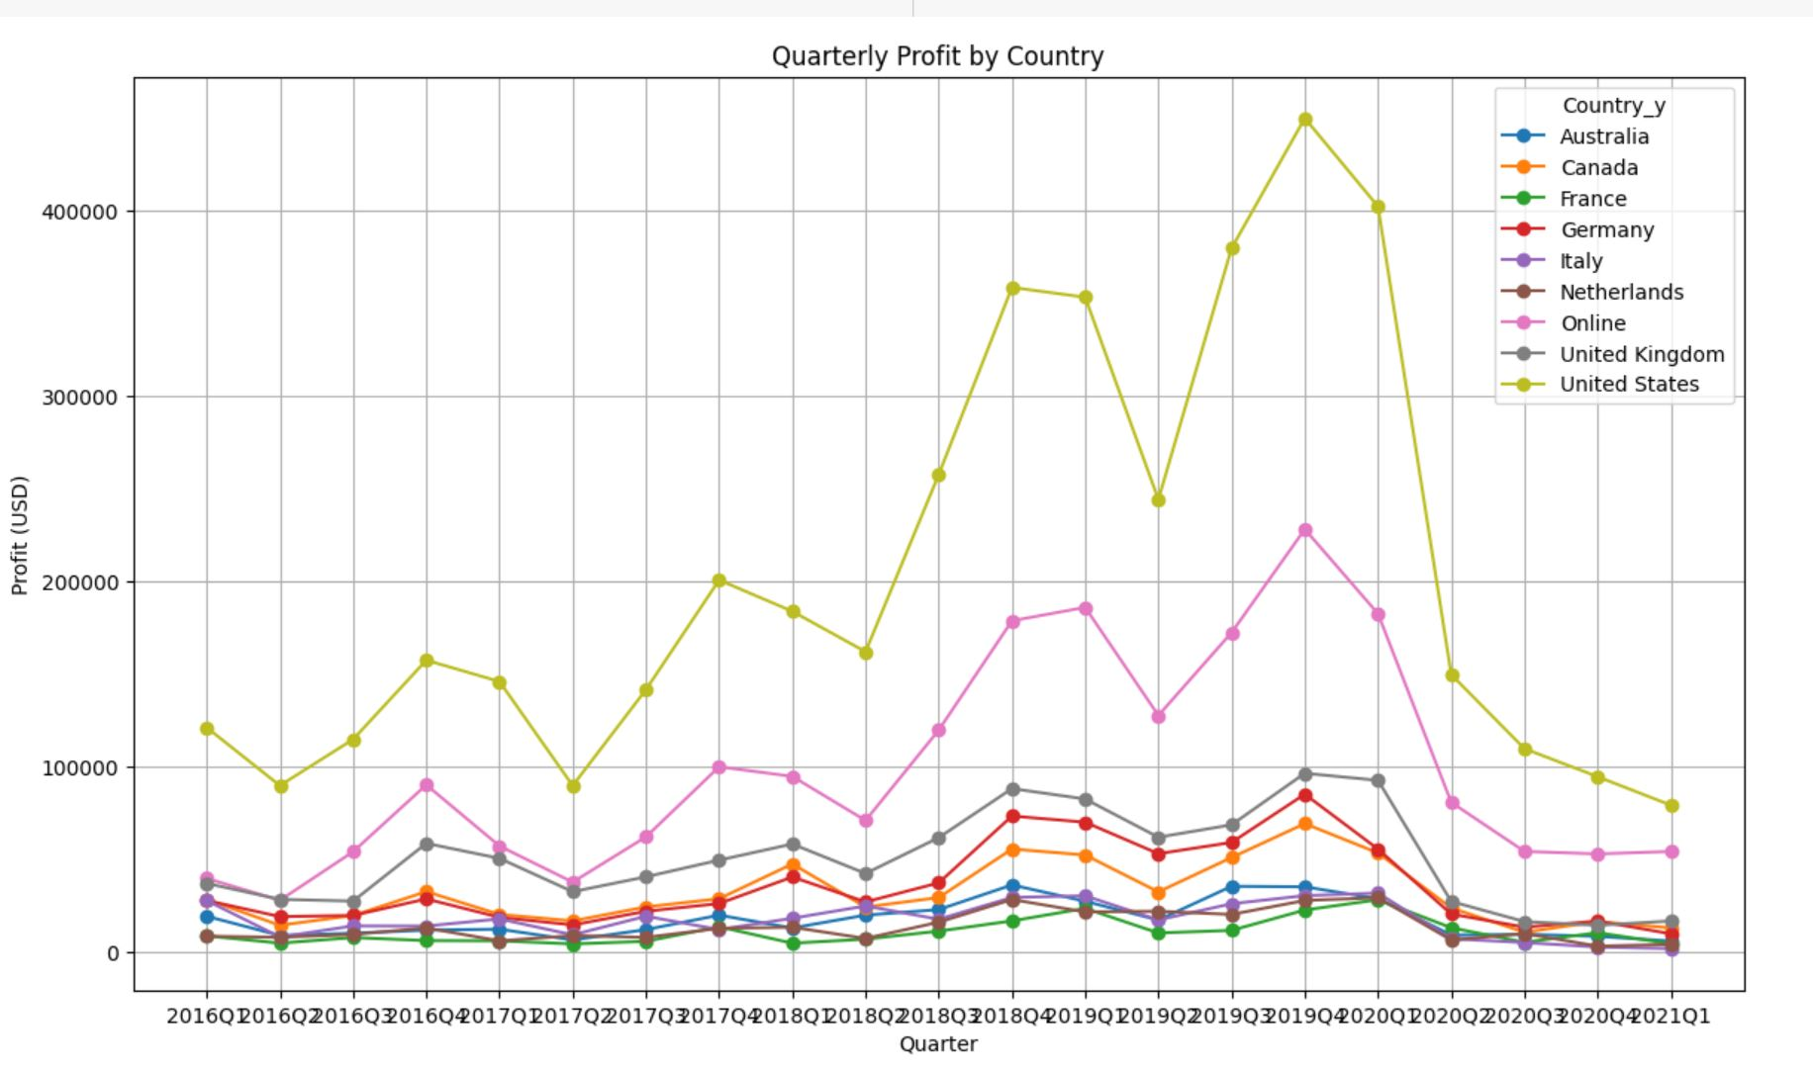
Quarterly Profit by Country

Slide 3
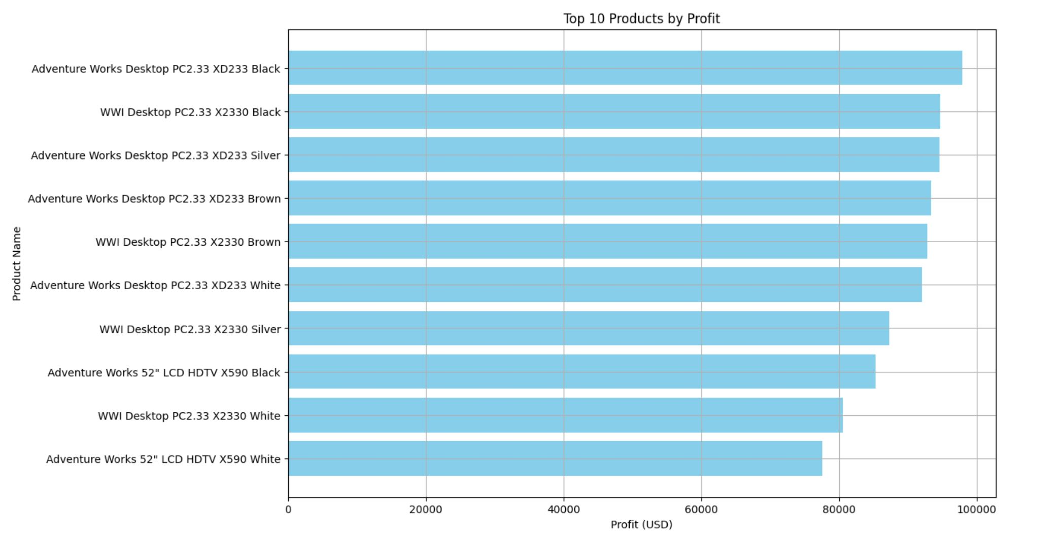
Top 10 Products by profit

Slide 4
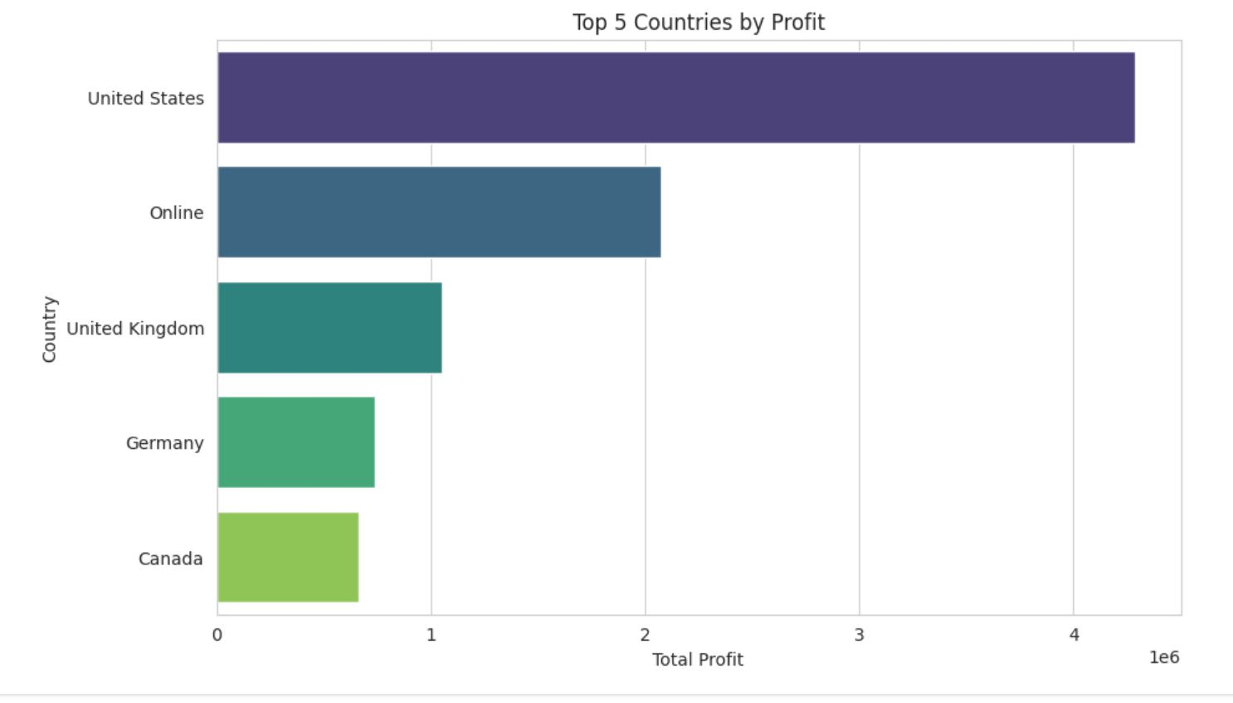
Plan: Focus on the top 5 countries with the highest profit Action: Develop customized marketing campaigns for these countries

Slide 5
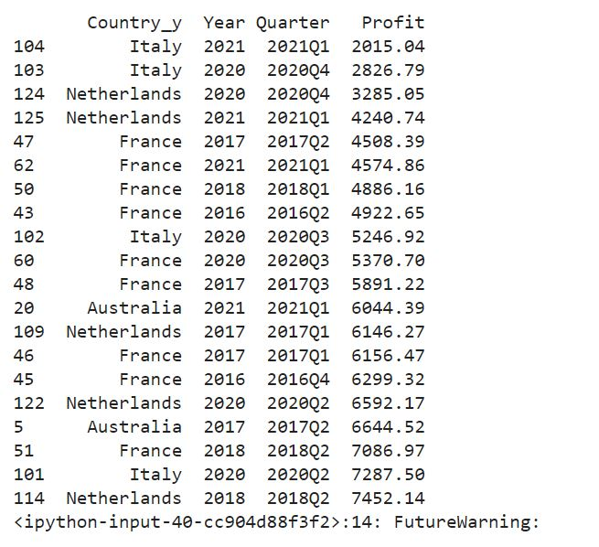
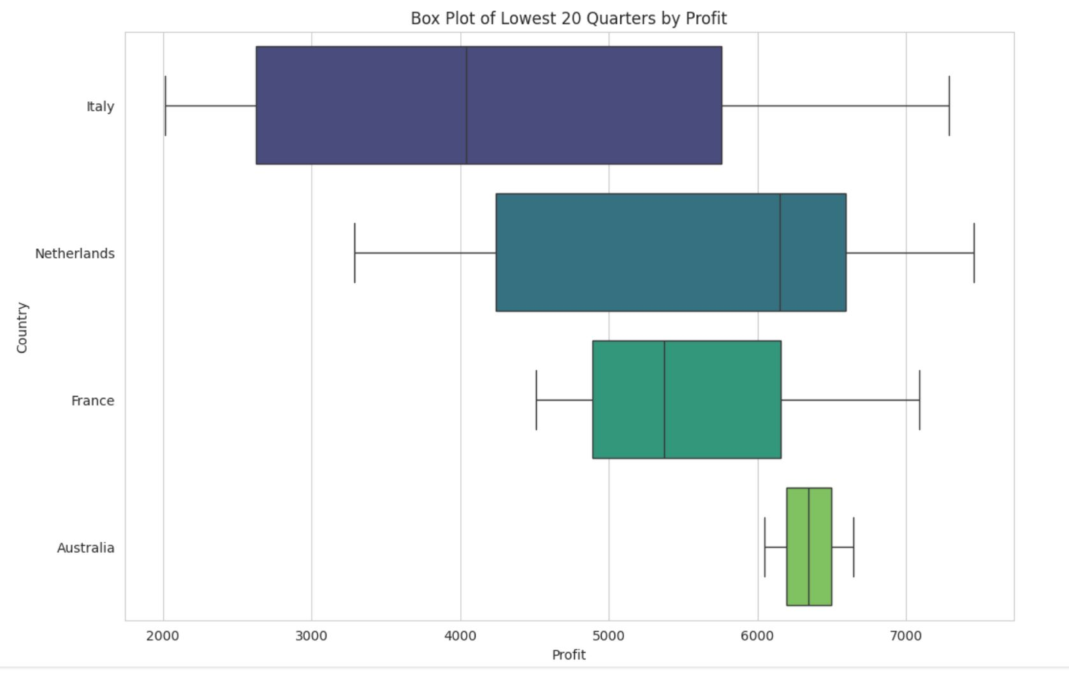
Plan: Focus on quarters with profits below the average Action: Design and launch promotional offers during these low-profit quarters to stimulate demand

Slide 6
Product Bundling
Plan: Use top-selling products and complementary products
Action: Create bundled offers combining these products

